Slide 1
JS
NPM
External packages - dependencies

Slide 2

OBJECTIVES
What NPM is used for ?
Install an NPM PACKAGE
Install DEPENDENCIES on an existing project

Slide 3
WHAT DID WE LEARN
LAST SESSION?

Slide 4


A back end is basically a program
running all day on a computer
NodeJS can execute JavaScript files
(BACK END)

Slide 5

To write your code, you can use other modules
Use Node built-in modules
Use your own modules
YOUR PROJECT
http
REQUIRE
REQUIRE
BACK
myLib1.js
os
REQUIRE
fs
myLib2.js

Slide 6
You can export variable or functions
library.js
main.js
let lib = require("./library.js");
let a = 2
let b = 2
lib.a
AVAILABLE
let c = 2
lib.b
AVAILABLE
module.exports.a = a;
lib.c
NOT AVAILABLE
module.exports.b = b;

Slide 7

What about installing a MODULE from the WEB?
INSTALL
BACK

Slide 8


PACKAGES
ARE THE TOOLS
OF YOUR APPLICATION
SEE ALL PACKAGES HERE https://www.npmjs.com/

Slide 9

A package is just a list of modules
MODULE
PACKAGE

Slide 10
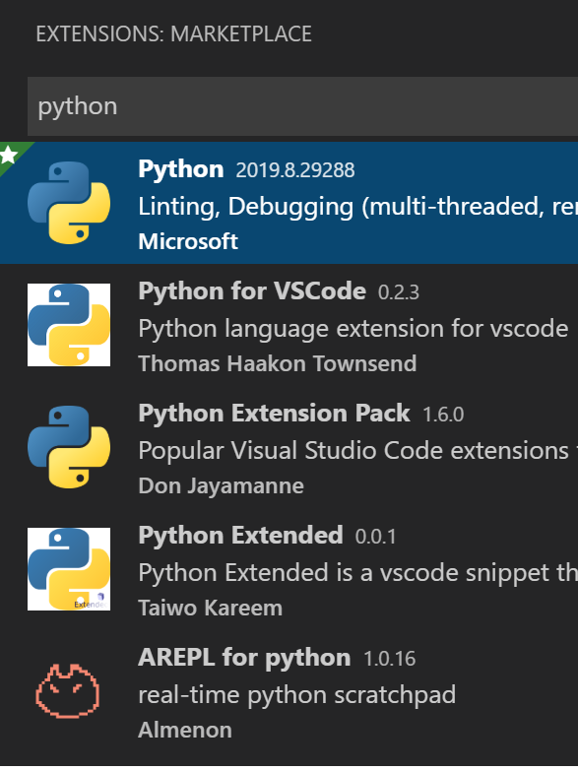
IN VSCODE, your install EXTENSIONS
Using the MARKETPLACE
to get some new TOOLS
IN NODE, your install PACKAGES
Using NPM
to get some new MODULES

Slide 11
#STEP 1 : Make your project an NPM project
Create a project and run:
npm init
What happen on your project?

Slide 12
#STEP 2 : Install an NPM package
Install a package
npm install colors
What happen on your project?
Notes:
Noted: shorthand we use npm i

Slide 13
#STEP 3 : Use your package
Create a JS file and require the package
const colors = require(colors');
console.log(colors.red('Hello world!'));
What happen when you run your code ?
Running code: node .

Slide 14

NPM downloads the package to the folder /node_modules
/node_modules
INSTALL
colors
MODULE
PACKAGE
YOUR
COMPUTER
NPM
REPOSITORY

Slide 15
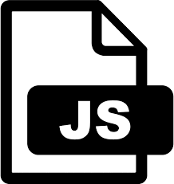
Then you can use it : require
/node_modules
REQUIRE
colors
MODULE
PACKAGE
YOUR
COMPUTER
NPM
REPOSITORY

Slide 16
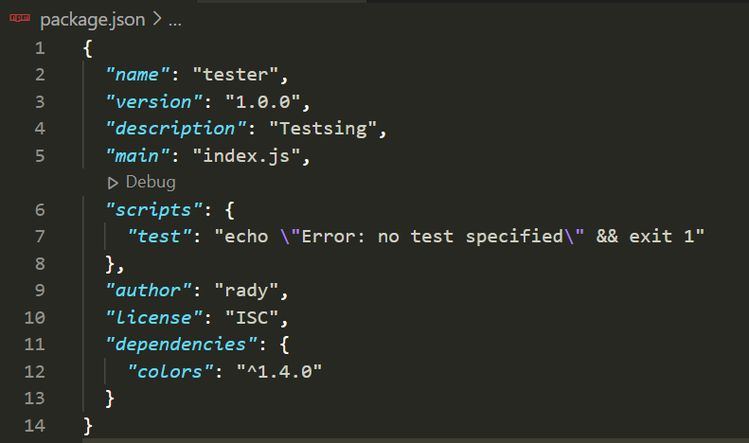
What is package.json?
Project information
Packages installed
= dependencies
Name of package
Version

Slide 17
Can we remove /node_modules ?
1 – Install another package : axios
npm install axios
What happen on your package.json ?
What happen on your /node_modules?
2 – Remove the folder /node_modules
3 – Install all your package dependencies again:
npm install
What happen on your /node_modules?

Slide 18

You should not send
/node_modules folder to your friend!
Contain a lot of
data
Instead run:
npm install
CHALK
1.7Go
1Go
EXPRESS
AXIOS
Will download
dependencies
defined in
package.json
700Mo
Notes:
Why don’t we give directly the packages ? And just the list ?
Because packages are heavy ! And maybe they are already installed in Ronan’s computer, so no need to make him download again…

Slide 19
ACTIVITY
ACTIVITY-1
Follow instructions on main.js

Slide 20
ACTIVITY
ACTIVITY-2
Follow instructions on main.js

Slide 21
OBJECTIVES
What NPM is used for ?
Install an NPM PACKAGE
Install DEPENDENCIES on an existing project

